Slide 1

Basic Counting

Slide 2
This Lecture
We will study some basic rules for counting.
Sum rule, product rule, generalized product rule
Inclusion-exclusion principle

Slide 3
Sum Rule
|S|: the number of elements in a set S.
A
B
If sets A and B are disjoint, then
|A ∪ B| = |A| + |B|

Slide 4
Sum Rule
A
B
If sets A and B are disjoint, then
|A ∪ B| = |A| + |B|
Class has 43 women, 54 men, so total enrollment = 43 + 54 = 97
26 lower case letters, 26 upper case letters, and 10 digits,
so total characters = 26+26+10 = 62

Slide 5
Sum Rule: Another Version
If there are n1 ways to do a task in one strategy (A) and n2 ways to do the same task in another strategy (B) where no two ways are same then irrespective of any strategy there n1 + n2 ways to do the task.

Slide 6
Sum Rule: Another Version
If there are n1 ways to do a task in one strategy (A) and n2 ways to do the same task in another strategy (B) where no two ways are same then irrespective of any strategy there n1 + n2 ways to do the task.
n1
A
B
n2
If sets A and B are disjoint, then
|A ∪ B| = |A| + |B| = n1 + n2

Slide 7

Product Rule
Given two sets A and B, the Cartisean product
If |A| = m and |B| = n, then
|A × B| = mn.
A = {a, b, c, d}, B = {1, 2, 3}
A × B = {(a,1),(a,2),(a,3),
(b,1),(b,2),(b,3),
(c,1),(c,2),(c,3),
(d,1),(d,2),(d,3) }
If there are 4 men and 3 women, there are
possible married couples.

Slide 8
Product Rule: Another Version
Suppose that a procedure can be broken down into two tasks (A and B). If there are n1 ways to do the first task (A) and n2 ways to do the second task (B), we can do the whole procedure in n1 × n2 ways!
If |A| = n1 and |B| = n2, then
|A × B| = n1 × n2.

Slide 9
EXAMPLES

Slide 10
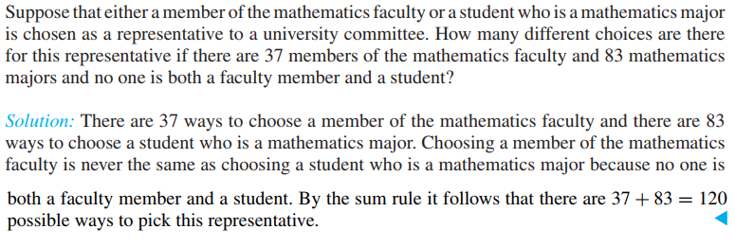

Slide 11
Math
Faculty
(37)
Math
Major
(83)
If sets A and B are disjoint, then
|A ∪ B| = |A| + |B| = 37 + 83 = 120

Slide 12
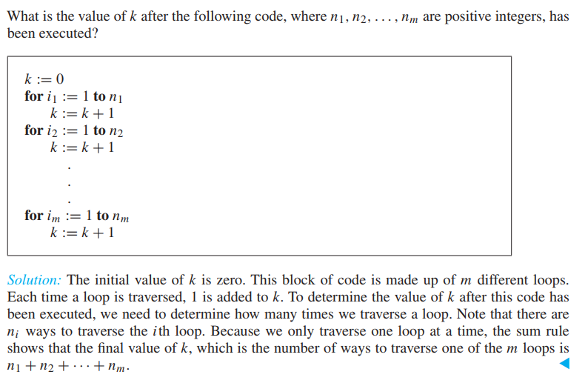

Slide 13
1 (n1)
2 (n2)
m (nm)

Slide 14



A1
A2
A3
Am

Slide 15
Palasi to Banani
Suppose you can go:
  from Palasi to Shahbag in 3 ways and
  Shahbag to Banani in 5 ways.
In how many ways, you can go from Palasi to Banani?
Yes, it is simply 3 × 5 = 15 ways.

Slide 16
CR
We want to choose CR
  One from the girls (say, 20 girls)
  One from the boys (say, 40 boys)
How many ways we can choose class representatives?
Yes, it is simply 20 × 40 = 800 ways.

Slide 17
Product Rule: Counting Strings
What is the number of length-4 strings from alphabet B ::= {0,1}?
Notice that the set of length-2 strings is just B × B
Similarly the set of length-4 strings is just B × B × B × B
And so the number of length-4 strings is
  = |B × B × B × B|
  = 2 · 2 · 2 · 2 = 2⁴
m^{n}.
The number of length-n strings from an alphabet of size m is
e.g. the number of length-n binary strings is 2^{n}
the number of length-n strings formed by capital letters is 26^{n}

Slide 18
Counting passwords
A computer system has a password consisting of 6, 7, or 8 characters.
Each of these characters must be a digit or a letter of the alphabet.
Each password must contain at least one digit.
How many such passwords are there?

Slide 19
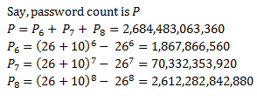
Counting passwords
Each character must be
  a digit (10 digits)
  or a letter (26 letters)
# of n characters strings
# of n letters strings
minus

Slide 20
Example: Counting Passwords
How many passwords satisfy the following requirements?
between 6 & 8 characters long
starts with a letter
case sensitive
other characters: digits or letters
L ::= {a,b,…,z,A,B,…,Z}
D ::= {0,1,…,9}

Slide 21
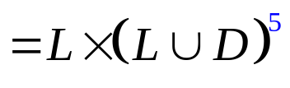

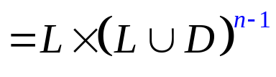
Example: Counting Passwords
L ::= {a,b,…,z,A,B,…,Z}
D ::= {0,1,…,9}
P₆ =

Slide 22
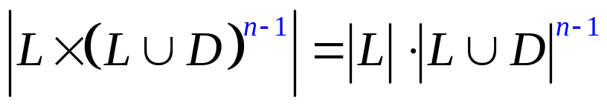
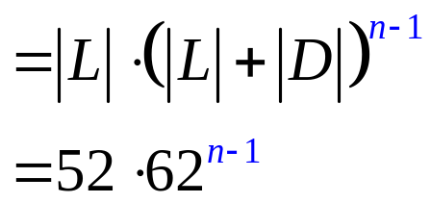
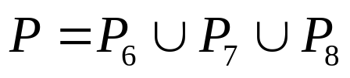
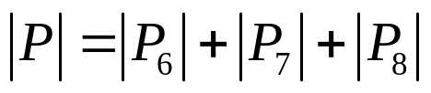

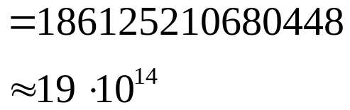
Example: Counting Passwords
The set of Passwords:
(counting by partitioning)

Slide 23
At Least One Seven
How many # 4-digit numbers with at least one 7?
count by 1st occurrence of 7:
  7xxx + o7xx + oo7x + ooo7
  where x represents any digit from 1 to 10,
  while o represent any digit from 1 to 10 except 7.
  Clearly, each number containing at least one 7 is in
  one of the above sets, and these sets are disjoint.
  Therefore, the answer to the question is:
  10³ + 9·10² + 9²·10 + 9³ = 3439
Method 1:
The set of 4-digit
numbers with 7 in
the first digit.
The set of 4-digit
numbers with 7 in
the second digit,
but the first digit
is not 7, and so on.
(counting by partitioning)

Slide 24
At Least One Seven
How many # 4-digit numbers with at least one 7?
Method 2:
|4-digit numbers with at least one 7|=
|4-digit numbers| − |those with no 7s|
= 10⁴ – 9⁴
= 3439
(counting the complement)
Counting the complement is a useful technique.

Slide 25

Defective Dollars
A dollar is defective if some digit appears
more than once in the 6-digit serial number.
How common are non-defective dollars?

Slide 26
Defective Dollars
How common are non-defective dollars?
10 possible choices for the first digit,
9 possible choices for the second digit, and so on…
So, there are 10x9x8x7x6x5
= 151200 serial number with all its digit different
There are totally 10⁶ = 1000000 serial numbers.
So, only about 15% of dollars are nondefective.

Slide 27
Generalized Product Rule
Q a set of length-k sequences. If there are:
n₁ possible 1st elements in sequences,
n₂ possible 2nd elements for each first entry,
n₃ possible 3rd elements for each 1st & 2nd,
…
then,
|Q| = n₁ · n₂ · n₃ · … · n_{k}

Slide 28
This Lecture
Sum rule, product rule, generalized product rule
Inclusion-exclusion principle

Slide 29
Sum Rule
If sets A and B are disjoint, then
|A ∪ B| = |A| + |B|
A
B
  What if A and B are not disjoint?

Slide 30

Inclusion-Exclusion (2 sets)
For two arbitrary sets A and B
A
B

Slide 31
Inclusion-Exclusion (2 sets)
Let S be the set of integers from 1 through 1000 that are multiples of 3 or multiples of 5.
Let A be the set of integers from 1 to 1000 that are multiples of 3.
Let B be the set of integers from 1 to 1000 that are multiples of 5.
It is clear that S is the union of A and B,
but notice that A and B are not disjoint.
A
B
|A| = 1000/3 = 333
|B| = 1000/5 = 200
A ∩ B is the set of integers that are multiples of 15, and so |A ∩ B| = 1000/15 = 66
So, by the inclusion-exclusion principle, we have |S| = |A| + |B| - |A ∩ B| = 467.

Slide 32

Inclusion-Exclusion (2 sets):
Subtraction Rule

Slide 33
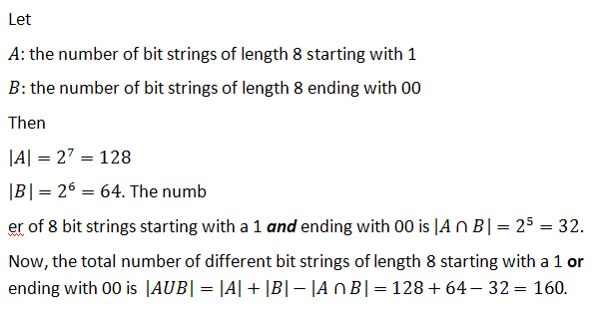
How many bit strings of length 8 start with a 1 or end with 00?

Slide 34
How many integers are there between 1 to 1000 inclusive that are not divisible by 3 or 4?

Slide 35
Inclusion-Exclusion (3 sets)
|A ∪ B ∪ C| = |A| + |B| + |C|
– |A ∩ B| – |A ∩ C| – |B ∩ C|
+ |A ∩ B ∩ C|
A
B
C

Slide 36
Inclusion-Exclusion (3 sets)
From a total of 50 students:
|A|
30 know Java
18 know C++
26 know C#
9 know both Java and C++
16 know both Java and C#
8 know both C++ and C#
47 know at least one language.
|B|
|C|
How many know none?
How many know all?
|A ∩ B|
|A ∩ C|
|B ∩ C|
|A ∩ B ∩ C|
|A ∪ B ∪ C|
|A ∪ B ∪ C| = |A| + |B| + |C| – |A ∩ B| – |A ∩ C| – |B ∩ C| + |A ∩ B ∩ C|
47 = 30 + 18 + 26 – 9 – 16 – 8 + |A ∩ B ∩ C|
|A ∩ B ∩ C| = 6

Slide 37
Inclusion-Exclusion (4 sets)
|A ∪ B ∪ C ∪ D| = |A| + |B| + |C| + |D|
– |A ∩ B| – |A ∩ C| – |A ∩ D| – |B ∩ C| – |B ∩ D| – |C ∩ D| + |A ∩ B ∩ C| + |A ∩ B ∩ D| + |A ∩ C ∩ D| + |B ∩ C ∩ D|
– |A ∩ B ∩ C ∩ D |
A
B
C
D

Slide 38
Inclusion-Exclusion (n sets)
What is the inclusion-exclusion formula for the union of n sets?

Slide 39
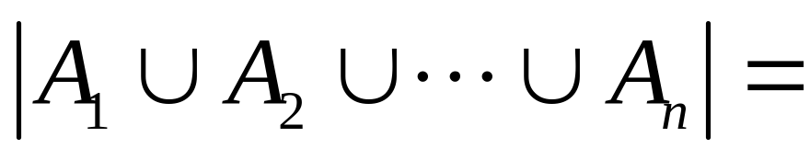
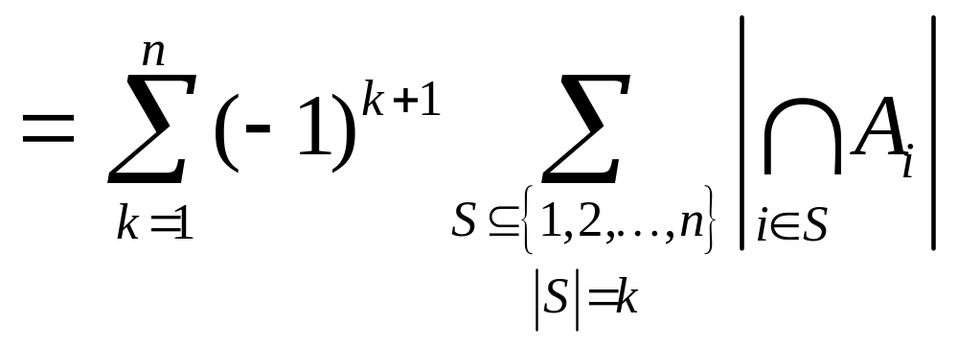
Inclusion-Exclusion (n sets)
sum of sizes of all single sets
– sum of sizes of all 2-set intersections
+ sum of sizes of all 3-set intersections
– sum of sizes of all 4-set intersections
…
+ (–1)^{n+1} × sum of sizes of intersections of all n sets

